Slide 1

PRESENTATION
IT204F
LAU ZI YU , CHIA MING JIE , NAJIB , HAIRIL

Slide 2
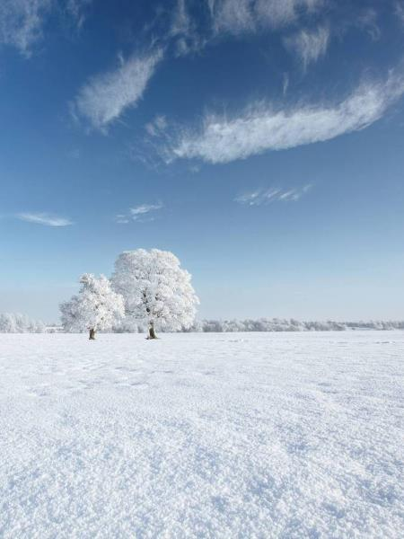
What will be covered
1. Introduction
2. Primary goals
3. Schedule
4. Homepage
5. Quiz
6. Game
7. E-learning
8. Business needs
9. Summary

Slide 3
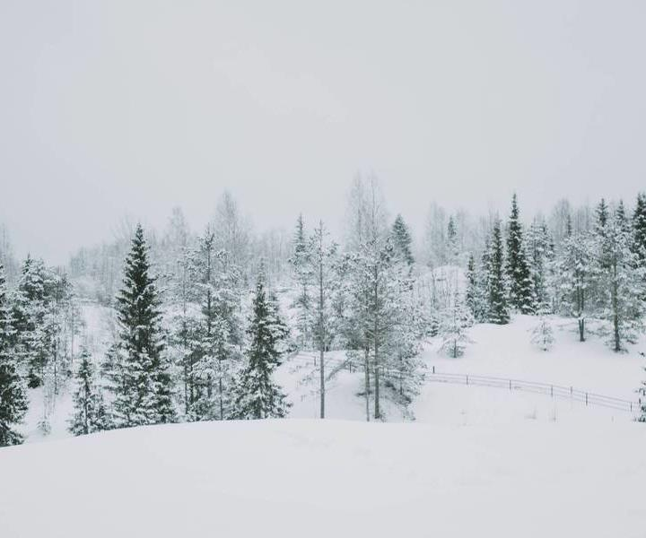
INTRODUCTION
Company MNZH is a company founded by Allen Tan in 2012 to help kids practice going green from a young age so that recycling will be with them till adulthood. MNZH makes cartoons helping children understand about recycling and the importance of recycling. The cartoon can be viewed on the Starhub channel. His goal is to make Singapore a more sustainable and eco-friendly country, but the objective is to educate kids so that in the future, they can pass down these habits to upcoming generations.

Slide 4

PRIMARY GOALS
By Ziyu and Ming Jie

Slide 5
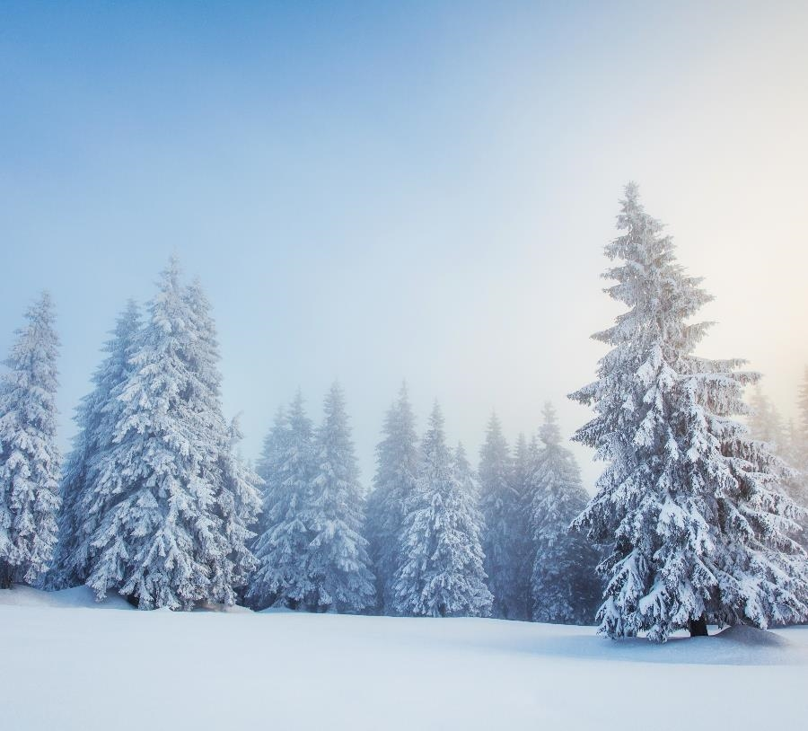

We focus on transforming environmental education into a fun and interactive experience. By combining technology, creativity and real-world sustainability practices. MNZH aims to nurture children to become responsible and eco conscious
MAIN GOAL

Slide 6
Schedule
 | Week 9 | Week10-13 | Week14-15 | Week 16
1 | Plan and communicate about how each other wants the project to look | Do our own individual parts | Collaboration | Last try and check
2 | What type of home page is suitable for everything | Update progress in the group | Fix issues | Submit
3 |  | Change accordingly to match with the other team-members
4

Slide 7
Timeline
Week 10
Everything should be planned finished
Week 13
Individual parts should be finished
Week 15
Coordination should be completed with no errors
Week 16
Last testing and Submission
Preparation for Presentation
Week 17

Slide 8
Plan For MNZH
Planning
Education for kids to go green
E-learning
Game
Kids must catch the recyclable items to earn points
Quiz
MCQ will pop out and kids must answer accordingly
Home page
Look visually appealing and must be able to link everyone's scratch there
Cartoon will ask and answer questions itself to demonstrate for the kids

Slide 9
Homepage - Najib
Combine together
Reason
Linking Quiz, Game and E-learning together.
The shop to purchase cosmetics.
Login.
Easier for kids to access the page.
The shop is to encourage the kids to do their best .
Login to save their account to prevent it from getting lost or misused.

Slide 10
Quiz – Ming Jie
Problem
MNZH Solution
Passive learning isn't enough, without tests we cannot confirm if the children fully understand the concept of going green.
Creating a short quiz that
Test environmental knowledge
Engage kids with graphics and simple language
Build confidence with immediate feedbacks

Slide 11
Quiz - Ming Jie
What it covers
Design Features
How to recycle properly
Conserving water and electricity
How pollution harm animals and nature
Everyday eco-habits
Multiple-choice questions (MCQ) with animated characters
Score tracking and encouraging messages
Audio and friendly animations to keep children engaged

Slide 12
Game - Ziyu
Catch items into the bin
Reason
Falling items from the sky
Catch with the bin
Catch the correct items
Point awarded when items is correctly collected
Motivation
Engaging
Interactive
Practice what they know & don't
Focus
12

Slide 13
E-Learning - Hairil
About
Reason
Interactive story
Cartoon animations with interactive elements
Teach children about sustainability
Simple and easy to understand
Children are engaged throughout the e-learning
Better understanding with visuals
Catered towards children

Slide 14
KAHOOT
Lack of awareness on environmental sustainability
Interactive learning is more engaging
Encourages self-directed learning
HOW DOES IT HELP

Slide 15
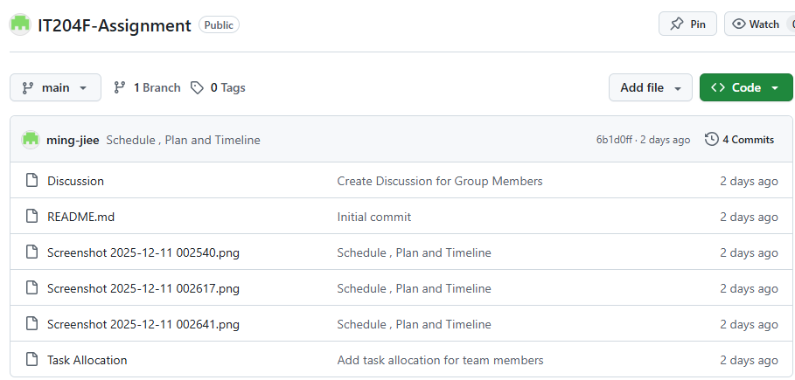
Our GitHub
https://github.com/ming-jiee/IT204F-Assignment

Slide 16

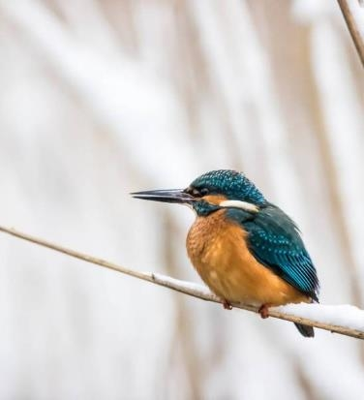
SUMMARY
At MNZH, we strive to help children understand the importance of being eco-friendly while keeping learning engaging and enjoyable. We want kids to have fun and develop a love for learning, rather than feeling reluctant or bored.

Slide 17
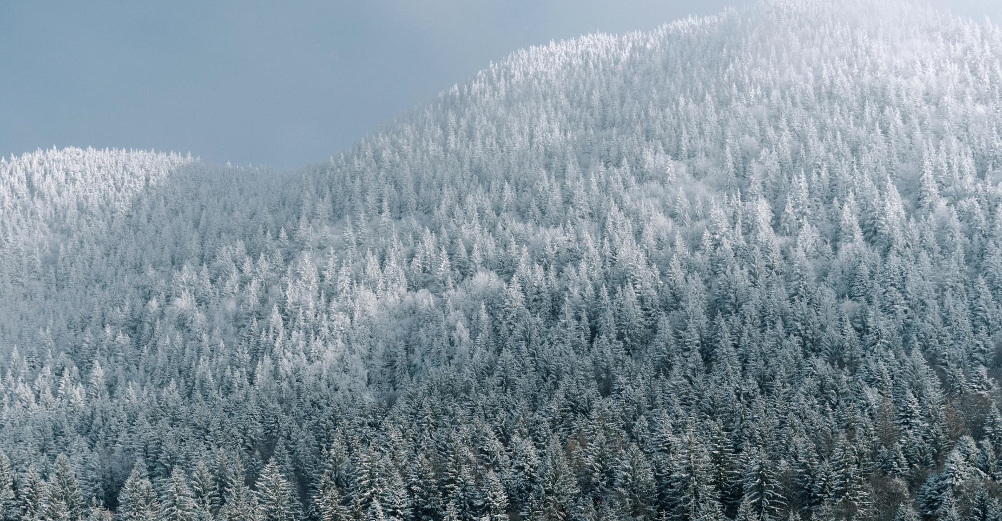
THANK YOU
For your kind attention

